Slide 1
The present and future of Joint Programmes:
a project based study
Shaping the next generation of Joint Programmes in Science and Technology
REDEEM 2

Slide 2
Background: why REDEEM 1
1
DD developed according to the needs of the providers
Often no feedback from the students
Often no correlation with the needs of the employers
DD promoted but no tools to provide the students with a clear picture on the impact
Existing studies are incomplete (focusing on other areas, on one type of DD only, on mobility only, not comparative, not combining qualitative and quantitative analysis, not bringing together all the stakeholders, not producing guidelines for future use)
2
3
4
5
Notes:
RM/AL see tonight

Slide 3
REDEEM 1 actions
State of the art in the 6 countries (7 partners)
Quantitative analysis: 1.600 respondents (alumni)
Hard facts
Motivations
Impact
Qualtitative analysis: 140 interviews+focus groups
Guidelines: comprehensive checklist for developers with recommendations
Repository of best practices

Slide 4
REDEEM 1 - General Conclusions
DD analyzed are highly appreciated by the graduates
The quality level has been stable over the past years
DD graduates are more satisfied about the programme than other groups
DD graduates earn more than their peers
Two main categories of programmes: compatibility vs complementarity
Impact analysis often lacking, incomplete or biased
There are many misconceptions still in place
Nature of the programme must be clear when designing and when recruiting
Notes:
Is to get a picture

Slide 5
REDEEM 1 - General Conclusions
Better communication towards all the target groups on the actual impact needed
Focused Marketing approach for DD vs exchange
Specific support and services for the category
Companies seek for DD profiles without realizing it
Both students and employers favor an active involvement of companies in all phases (curriculum design, teaching with credits, definition of research topics, hosting mandatory internships)
DD+ is the inevitable next step: creation of newly designed DD programmes based on the results and recommendations of this project Redeem 2
Notes:
Is to get a picture

Slide 6
Now: why REDEEM 2?
REDEEM 1: good preliminary results that need to be further exploited
Need for further evidence to promote JPs
Need for more comparable data from alumni and institutions (country, filed, programme, socio-economic background,…)
Focus on the most recent graduates (3 last cohorts)
Better information and communication towards companies (How?)
Need to reform programmes (How?)
Need to involve companies (we know why, but how?)
Platform for the EUI

Slide 7
Full Partners
KTH Royal Institute of Technology, Stockholm
UPC Universidad Polytecnica de Catalunya, Barcelona
TUD Technische Universität, Darmstadt
KIT Karlsruhe Institute of Tehnology
AALTO Aalto University, Helsinki
IST Instituto Superior Tecnico, Lisboa
TALTECH Tallinn University of Technology, Tallinn
CVUT Czech Technical University, Prague
Associated Partners
CLUSTER network
T.I.M.E. association

Slide 8
Definitions – Bologna Yerevan meeting
Joint programme is understood as an integrated curriculum coordinated and offered jointly by different HEIs, leading to joint or multiple degrees.
Joint degree - a single document awarded by HEIs offering the joint programme and nationally acknowledged as the recognized
award of the joint programme.
Multiple degree – separate degrees awarded by issuing separate diplomas by the participating HEIs. If two degrees are awarded, it is a “double degree”.

Slide 9
Definitions – Paris Communiqué
… “In order to encourage the development of more joint programmes and joint degrees, we will also enable and promote the use of the “European Approach for Quality Assurance of Joint Programmes” in our higher education systems.
We welcome and will promote the development of the Database of External Quality Assurance Results (DEQAR)”…
…”We will foster and extend integrated transnational cooperation in higher education, research and innovation, for increased mobility of staff, students and researchers, and for more joint study programmes throughout the whole EHEA.
We take note with interest of the recent EU initiative on ‘European Universities’ and we will encourage all our higher education institutions to work in such new settings.”…

Slide 10
Our definition
Joint Programmes here used as a general term covering all the forms of academic cooperation at any education level leading to the deliverance of a programme with embedded mobility offered jointly by at least two HEI located in two different countries.
We talk about Joint Programmes leading to a Joint or Multiple Degree

Slide 11
REDEEM 2
September 2018 to August 2021
Institutional analysis ongoing (please contribute)
Alumni survey ongoing (please contribute)
Training event in December 2019
Dissemination event in Prague (spring 2020)
Development of innovative JPs in 2020/21
Final event Stockholm spring 2021
Notes:
Is to get a picture

Slide 12
REDEEM 2
Institutional Approach

Slide 13
REDEEM 2 – Institutional survey
Part 1: General information: number of existing JPs/DDs, structure of the JPs, certification awarded, average number of students enrolled, most popular countries, top fields, typical language of instruction.
Part 2: student enrollment and support: JP alumni chapter/association, enrollment procedures, evaluation system, tutoring.
Part 3: Funding and sustainability: sustainability, main sources of funding.
Part 4: benefits and constraints: motivations to develop JPs, main perceived benefits, main challenges, legal requirements/constraints that complicate the setting up of JPs.
Part 5: companies involvement: how, nature of the collaboration, main benefits, obstacles.
Notes:
Is to get a picture

Slide 14
REDEEM 2 – Institutional survey
Characterization:
145 HEIs worldwide responded
Geographical distribution: Europe 66%, Asia 15%, LA 12%, Oceania 5%, NA 3%
Good distribution in term of HEIs size
Existing JPs/DD per institution:
Average: 18
Max: 180
Ratio DD/JPs: 3,6/1,0
Notes:
Is to get a picture

Slide 15
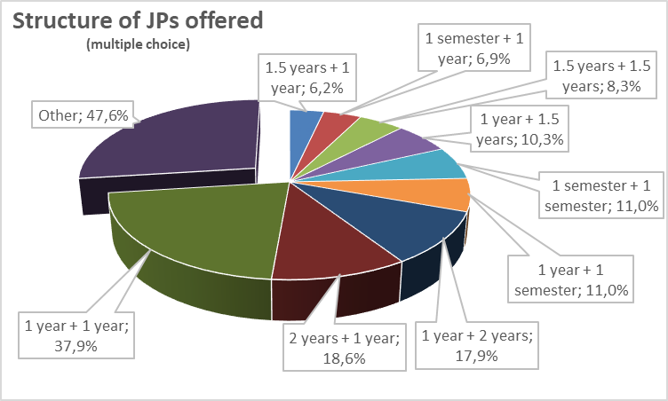
REDEEM 2 – Institutional survey
Notes:
Is to get a picture

Slide 16
REDEEM 2 – Institutional survey
Type of certificate awarded for the joint programmes | %
Each involved university issues a separate diploma | 61,4%
Each involved university issues a separate diploma with the addition of a joint certificate/diploma supplement | 24,8%
Only one joint diploma is awarded to the students on behalf of both/all involved universities | 17,2%
Other | 6,2%
Notes:
Is to get a picture

Slide 17
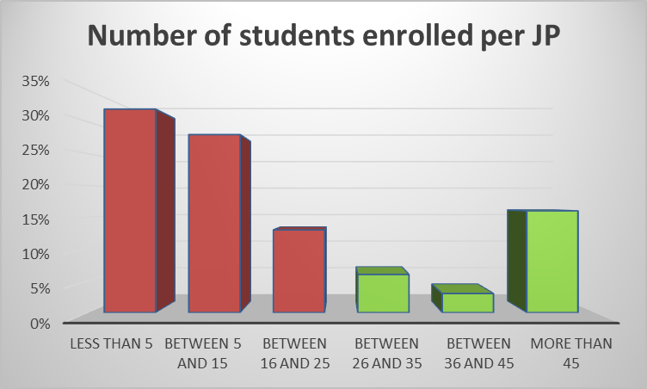
REDEEM 2 – Institutional survey
Notes:
Is to get a picture

Slide 18
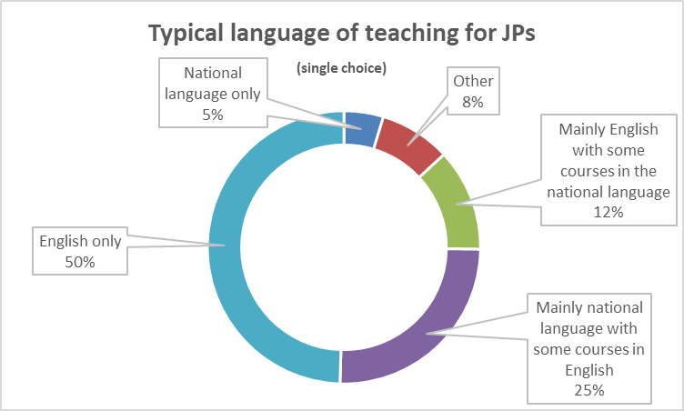
REDEEM 2 – Institutional survey
Notes:
Is to get a picture

Slide 19
REDEEM 2 – Institutional survey
Do you have a specific alumni chapter/association for joint programme graduates? | %
No, and it is not planned | 62,8%
Yes, but only for graduates from a specific joint programme | 16,0%
No, but it is being created | 13,8%
Yes, for all the graduates from any joint programme | 7,4%
Notes:
Is to get a picture

Slide 20
REDEEM 2 – Institutional survey
Do you have a specific association for the current joint programme students? | %
No, and it is not planned | 62,2%
Yes, open to all students | 23,3%
Yes, but only for studants from specific programmes | 7,8%
No, but it is being created | 5,6%
Only the diploma of the home university is awarded with mention of the joint educational initiative in the diploma supplement | 1,1%
Notes:
Is to get a picture

Slide 21
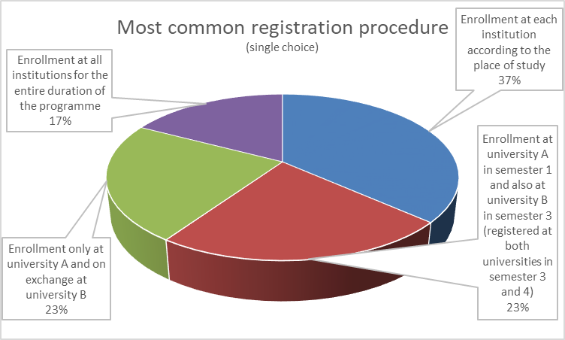
REDEEM 2 – Institutional survey
Notes:
Is to get a picture

Slide 22
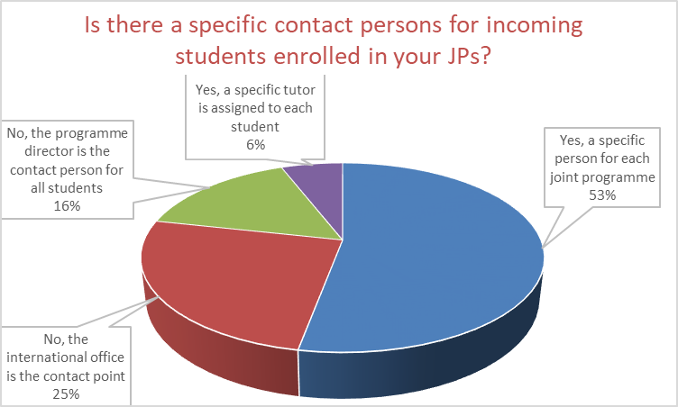
REDEEM 2 – Institutional survey
Notes:
Is to get a picture

Slide 23
REDEEM 2 – Institutional survey
What are the motivations for your university to develop JPs? | Average (1 - Not Relevant ; 4 - Extremely Relevant)
Advancing internationalization | 3,7
Raising international visibility/prestige | 3,5
Recruit talented and motivated students | 3,4
Broadening education offerings | 3,3
Strengthening research collaboration with the partner universities | 3,1
Increasing foreign students enrollment | 3,1
Responding to student demand | 2,8
Responding to particular market demand | 2,4
Increasing revenue | 1,8
Institutional rationale
Students rationale
Employers rationale
Notes:
Is to get a picture

Slide 24
REDEEM 2 – Institutional survey
What are the perceived benefits of having JPs in place? | Average (1 - Not Relevant ; 4 - Extremely Relevant)
Increased international visibility | 3,5
Development of strategic partnerships with the involved universities | 3,5
Increased internationalization of campus | 3,4
Recruitment of high potential students | 3,3
Recruitment of more international students | 3,1
Further joint programmes created following the previous experiences | 3,0
Greater collaboration between faculty | 3,0
New research projects with the involved academics at the partner university | 2,9
Greater collaboration between administrative staff | 2,4
Institutional rationale
Students rationale
Notes:
Is to get a picture

Slide 25
REDEEM 2 – Institutional survey
What are the main challenges associated with setting up new JP? | Average (1 - Not Challenging ; 4 - Extremely Challenging)
Funding | 3,2
Sustainability | 3,1
Curriculum design | 3,0
Legal issues | 2,9
Accreditation | 2,8
Fees structure | 2,6
Academic calendar | 2,5
Institutional support | 2,5
Degree duration | 2,4
Credit transfer | 2,3
Notes:
Is to get a picture

Slide 26
REDEEM 2 – Institutional survey
Notes:
Is to get a picture

Slide 27
REDEEM 2 – Institutional survey
General Conclusions:
Separate diplomas are still the rule (85%)
Extremely wide range of structures with growing 1+1 year JPs
Bilateral vs Multilateral = 50/50
Size of the JPs: 50% of JPs have less than 25 students
Motivation: focus still on the institution
Challenges: funding and sustainability
Involvement of employers still low (18%)
Almost half of the respondents (46%) don’t have a specific quality evaluation system for JPs
English is the dominant language
Notes:
Is to get a picture

