Slide 1




Slide 2
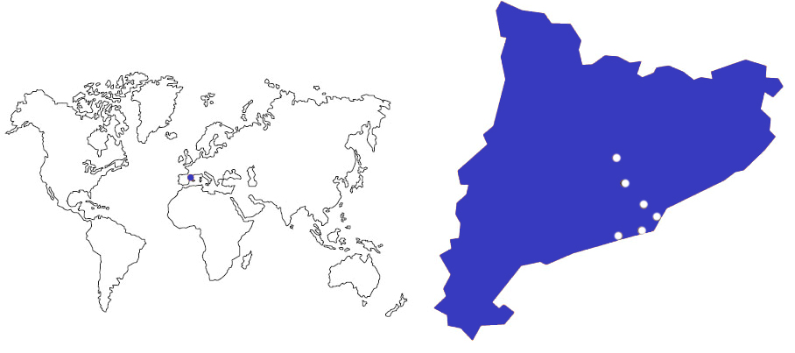
UPC BARCELONATECH
Manresa
Terrassa
Sant Cugat
Barcelona
Vilanova i la Geltrú
Castelldefels
Leading Technology at the south of Europe

Slide 3
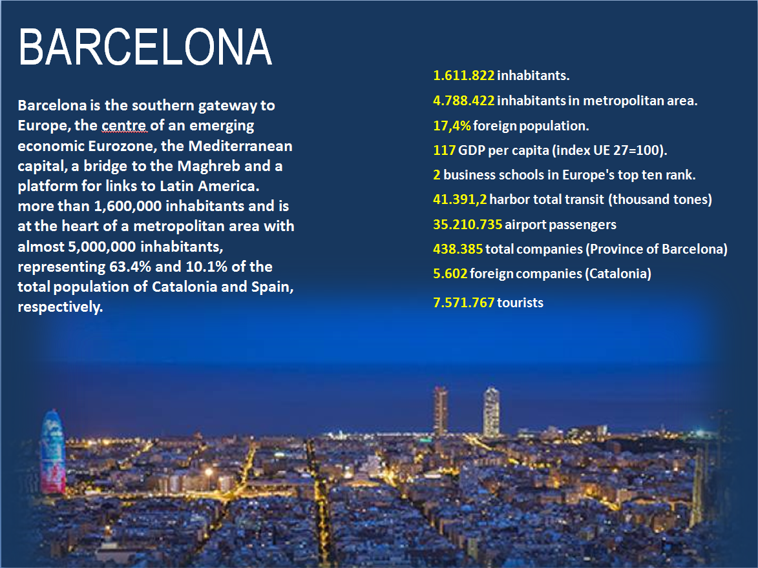

Slide 4

Education, Research, Innovation, Internationalization

Slide 5

The Universitat Politècnica de Catalunya – BarcelonaTech is a public institution of Higher Education and Research, specialised in the areas of Architecture, Engineering, Science and Technology.

Slide 6

3,066
205
30,864
^{teaching}
^{and research staff}
^{research groups}
^{students}
21
^{Schools in 8 campus}
26%
71
52%
^{bachelor’s degrees}
²⁰¹⁸⁻¹⁹
international master’s degree students
48
76
international doctoral degree students
^{(78% of them non EU)}
^{master’s degrees}
²⁰¹⁸⁻¹⁹
^{doctoral programmes}
²⁰¹⁸⁻¹⁹
724
higher education institutions with student
^{exchange agreements}

Slide 7
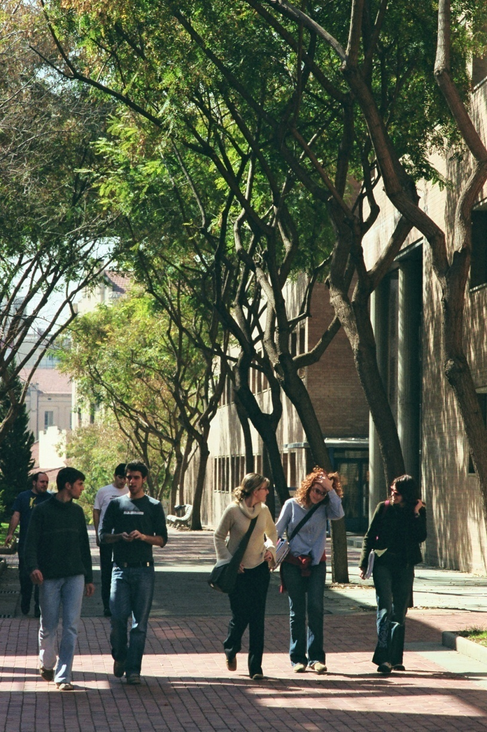
Fields
Architecture and Urban Planning
Aerospace Engineering
Agricultural and Biosystems Engineering
Civil, Environmental and Geological Engineering
Computer Science
Engineering for Industry: Energy, Biomedical, Chemical, Electrical, Materials and Mechanical
Naval, Maritime and Nautical Engineering
Telecommunications and Electronic Systems Engineering
Applied Sciences: Mathematics, Statistics, Physics, Optics and Photonics

Slide 8
Education
27,012
Undergraduate and master students
2,157
PhD students
71 Undergraduate degrees 2018-2019
49
PhD programs
3 Erasmus Mundus
2018-2019
76
Master’s programs
6 Erasmus Mundus
25 fully in English
2018-2019
54,440
UPC Alumni
2,775
Continuing education students: Life-Long Learning Program, corporate training, and other courses
4,884
Students Internships

Slide 9
Reputation
Shanghai Ranking of Academic Subjects, 2017
Among the top 10 universities in the world in Technology and Instrumental Science, among the 25 in Telecommunications Eng., among the 50 in Computer Sciences, in Water Resources and in Remote Sensing, and among the 75 best universities in the world in Electrical and Electronic Eng., in Automatic Control and in Civil Engineering.
QS Top 50 under 50 -2017-2018
Among the 25 best universities under the age of 50.
QS World University Rankings by Subject, 2018
Among the 25 best universities in the world in Architecture and Built Environment, among the 35 in Civil and Structural Engineering, among the top 100 in the broad subject areas Engineering and Technology and the specific subjects Telecommunications, Electrical and Electronical Engineering, Mathematics, Computer Science and Information Systems, and Art and Design.

Slide 10
Research to Innovate
3,066
Researchers
grouped in
205
Research groups
2,131
Papers in scientific journals
1,068
new research projects
559
PhD theses presented
138
Technical and scientific awards

Slide 11
Innovation
From 1998:
303 spin-off and start-up
586 Patent licenses
(from 2009 to 2017)
58.8 MEUR
Research income 19,500,000 € of wich comming from contracts with companies
ESA (European Space Agency)
Business Incubation Center
Located in the UPC and supported by the UPC
2,697
Sponsoring and collaborating companies

Slide 12

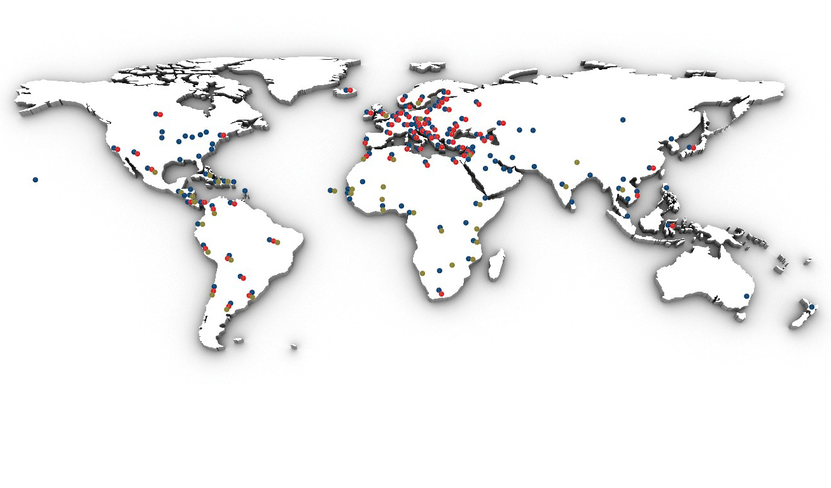


Slide 13
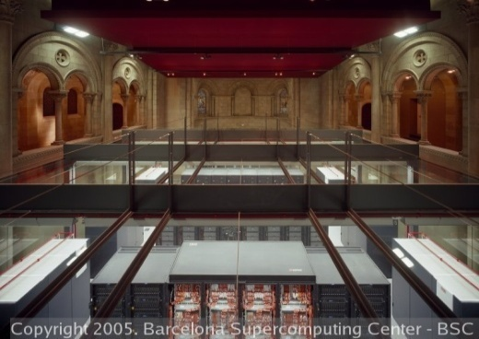
Internationalization
UPC BARCELONATECH is the Spanish university with the highest number of international university students of Ph.

Slide 14
Internationalization
358
Memoranda of understanding
with international institutions
48
Double degree agreements
25
Master’s programs fully in English
2,828
Students in international exchange programs
International students:
Doctorate: 58%, 78% of them, are from outside the EU
Master: 33,9%, 83% of them, are from outside the EU

Slide 15
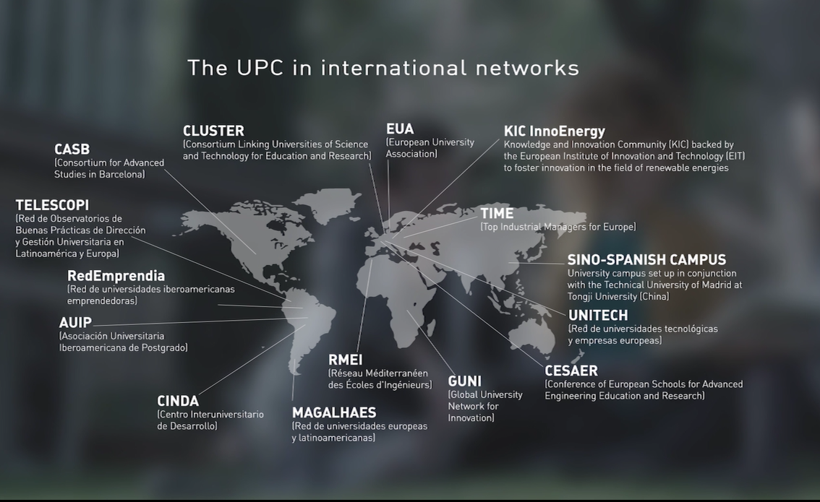
Alliances

Slide 16


















Alliances: CLUSTER

Slide 17
Social Responsibility
58 development cooperation projects in 26 countries
19 development cooperation groups with NGOs
23,719 primary and secondary school students participate in scientific and technological dissemination activities
582 science and technology
Workshop in last academic year

Slide 18
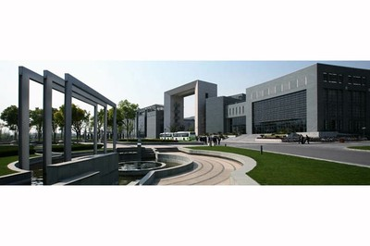
SinoSpanish Campus
at Tongji University
Inaugurated in 2012 together with Universidad Politécnica de Madrid
Sino-Spanish Campus UPC-UPM at Tongji University

Slide 19
SSC at TU: Main Goals
Education
  Student Exchanges
  Double Degrees
  Organization of a Summer School
Research
  Teachers mobility
  Joint Projects
  Organization of Workshops and scientific Conferences
Culture
  Cultural exchanges
  Dissemination of Catalan and Spanish culture
  Organization of cultural and recreational activities

Slide 20

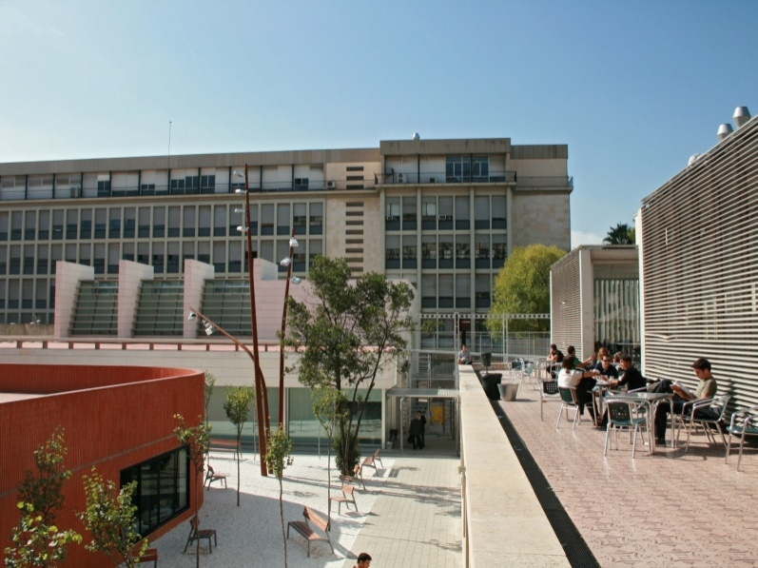
Campus of International Excellence – CEI
BKC establishes a framework for strategic collaboration which is key to providing the local environment with a solid, internationally recognized scientific and technological project, permitting the evolution of the local environment by means of an integrated social model based on innovation and sustainable development

Slide 21

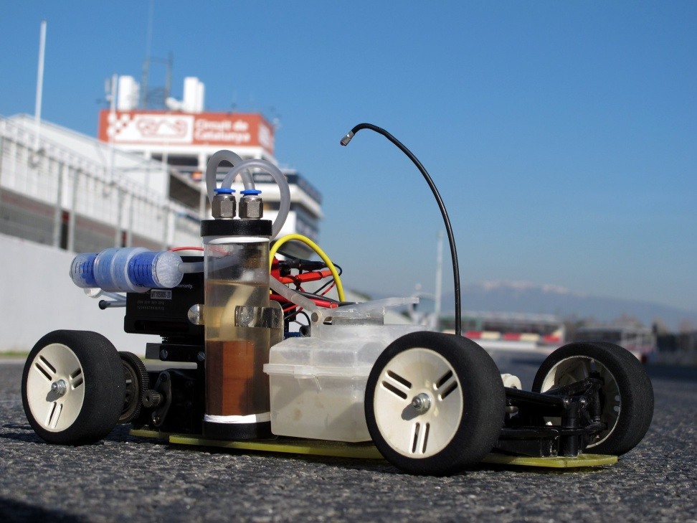
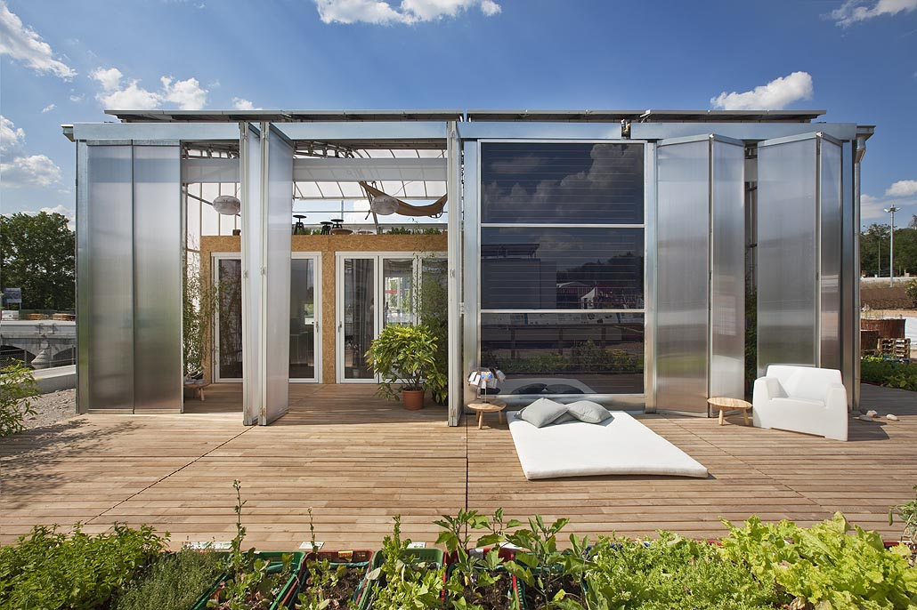
Energy Campus
The Energy Campus is a strategic consortium of several agents working together in the international arena to harness the potential of changes to the energy model while endorsing principles of social responsibility.

Slide 22
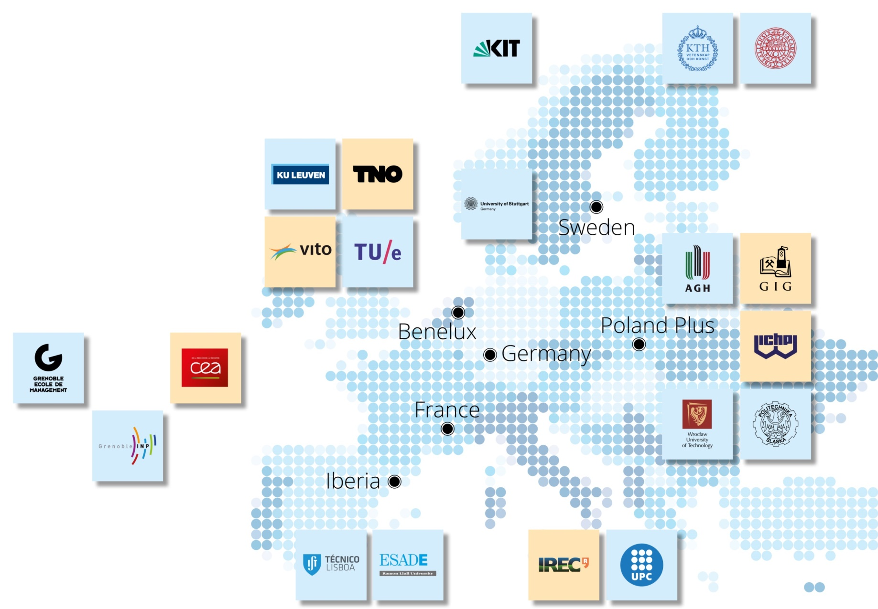
KIC Innoenergy
Making connections:
the power of the network
6 co-location centres
27 shareholders
160 additional partners
Activities in 17 countries
Our Shareholders
Research Institutes
Universities
Co-location Centres

Slide 23
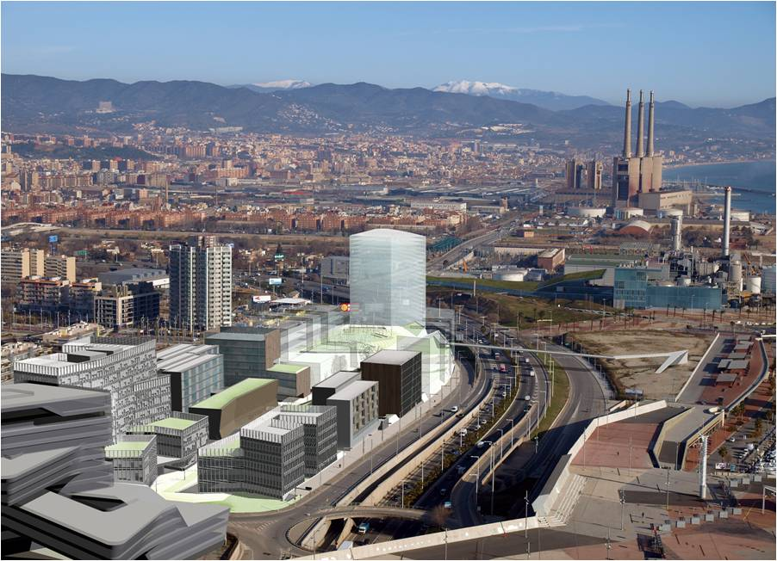






KIC Innoenergy - Iberia
Formal partners:
ESADE
Gas Natural FENOSA
Institut de Recerca de l’Energia de Catalunya-IREC
Instituto Superior de Lisboa
Universitat Politècnica de Catalunya
Associate partners:
Ciemat
Energías de Portugal
Iberdrola
Tecnalia Research and Innovation

Slide 24
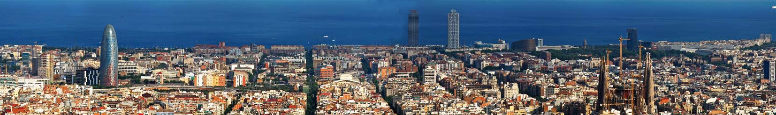
Global Technology Leading Innovation
Barcelona, amongst the 10 best student cities in Europe!*
* According to QS Best Student Cities 2017 Ranking

