Slide 1
Tallinn University
of Technology
(TalTech)
Fjodor Sergejev
Vice Dean for Academic Affairs
TalTech School of Engineering
17.09.2018

Slide 2
Tallinn University of Technology –
Creating a brighter future!
Established in 1918, Tallinn University of Technology (TalTech) is the flagship of Estonian engineering and technology education and research, where higher education can be obtained at all levels in engineering, technological, natural, and social sciences.
The mission of TalTech is to be a promoter of science, technology and innovation and a leading provider of engineering and economic education in Estonia.
TalTech values professionalism and reliability, entrepreneurship and innovation, openness and cooperativeness.

Slide 3
Tallinn University of Technology –
Creating a brighter future!
The vision of the University is innovative Estonia in a sustainable world, where TTÜ has a specific role:
TTÜ is an internationally outstanding university of engineering
and technology, which brings together motivated employees and ambitious students.
The university, relying on academic competencies and professional management, responds actively to the needs of the rapidly developing society and is involved in tackling the challenges
of the digital era.
Cooperation between the university, enterprises and the public sector contributes significantly to knowledge and welfare in the society.

Slide 4
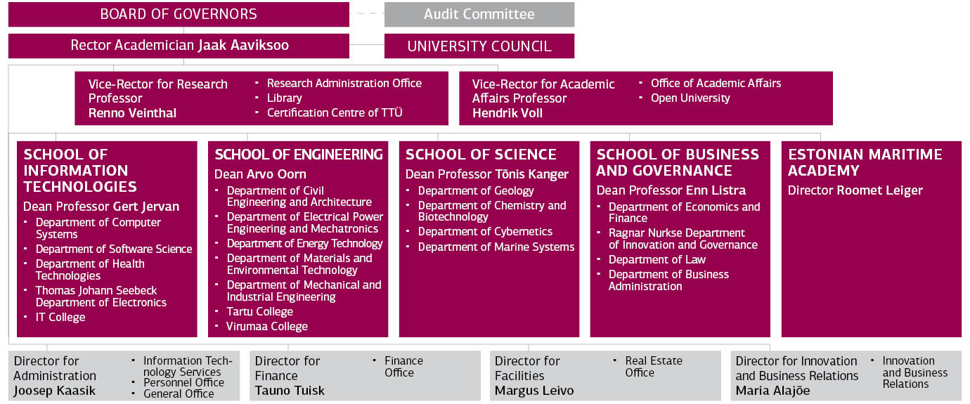
TTÜ struktuur 2018

Slide 5
Research and development
Every TTÜ scientific publication was quoted 4.89 times on average during
the last five years.
Local
authorship
Main partner countries in joint publications
Finland 57
Sweden 32
Latvia 26
Russia 43
1,221
scientific publication
USA 41
Intenational
co-authorship
Germany 46
France 25
In 2017
597
Doctorates attended TTÜ
Patent applications filed for TTÜ
International doctorates 128
11
9
48
62 PhD’s were defended (2017)
applications
received patents
valid patents

Slide 6
Students and curricula
11,070 in TTÜ
1,506
International students
46,155
students enrolled
in universities
in Estonia
11,208
students are
enrolled
in TTÜ
Curricula:
93
In 2017 TTÜ admitted
33
558
international students
Students graduated in 2017
2322
3455
students
International curricula,
incl. 6 joint programmes
and 1 double degree programme
Notes:
Panen kirja kõik ühisõppekavad, mis TTÜs (sh inseneriteaduskonna omad), kus TTÜ on juhtivpartner:
Küberkaitse (TÜga) - Cybersecurity
Materjalid ja protsessid jätkusuutlikus energeetikas (TÜga) - Materials and Processes for Sustainable Energetics
Disaini ja tehnoloogia tulevik (EKAga) - Design and Technology Futures
Riigisisesed ühisõppekavad, kus TTÜ on partner:
Tarkvaratehnika (TÜga) - Software Engineering
Kutseõpetaja (TLÜga) - Vocational Teacher (est)
Rahvusvaheline ühisõppekava:
Avaliku sektori innovatsioon ja e-valitsemine/Public Sector Innovation and e-governance (TTÜ, Leuveni ja Münsteri ülikooli ühisõppekava, vastuvõtt Leuveni ülikoolis).

Slide 7
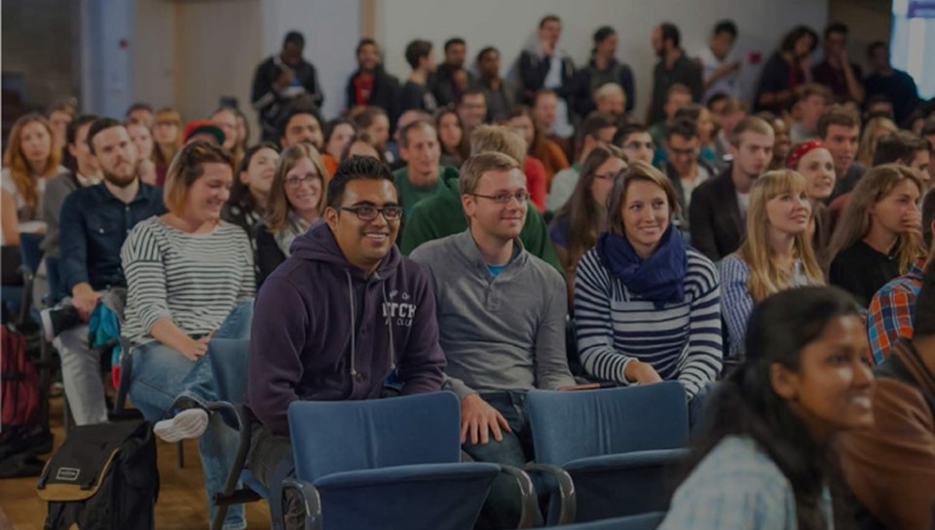
34% of all international students in Estonia attend TTÜ
TOP10 home countries of
TTÜ international students:
Finland | 409 |  | Georgia | 89
Nigeria | 115 |  | Russia | 72
India | 98 |  | Pakistan | 49
Ukraine | 92 |  | Bangladesh | 45
Turkey | 91 |  | Iran | 42
International
students from
94 counties
7

Slide 8
Staff and money
Doctorate / junior
researchers 102
46
International
academic staff 153
Average age
51
Professors
111
Academic staff
1,019
Different nationalities
Revenue from studies
Total staff
1,837
48.9%
Female staff
Revenue from studies
€ 49.720 mln
Revenue from research
and development
Revenue from research and development
€ 34.146 M
Operating grants from state budget for formal education
€ 38.865 M
External funding
€ 5.364 M

Slide 9


Double degree study programme
MSc MECHATRONICS DOUBLE DEGREE PROGRAM
TTÜ (Tallinn) and University ITMO (St. Petersburg).
Option for MSc Mechatronics students to obtain additional experience from University ITMO and to get two MSc Diplomas (one from TUT and another from University ITMO):
Completing at least 1st and 2nd semester MAHM courses at TTÜ.
Courses of the 3rd semester must be taken at University ITMO (student will study full semester in St. Petersburg).
Final Thesis will be co-supervised by TUT and University ITMO professor/researchers.
Defense of the Final Thesis will occur in front of these two Universities joint defense board.
More information: https://www.ttu.ee/institutes/department-of-electrical-power-engineering-and-mechatronics/studies-29/msc-mechatronics-double-degree-program-2/

Slide 10
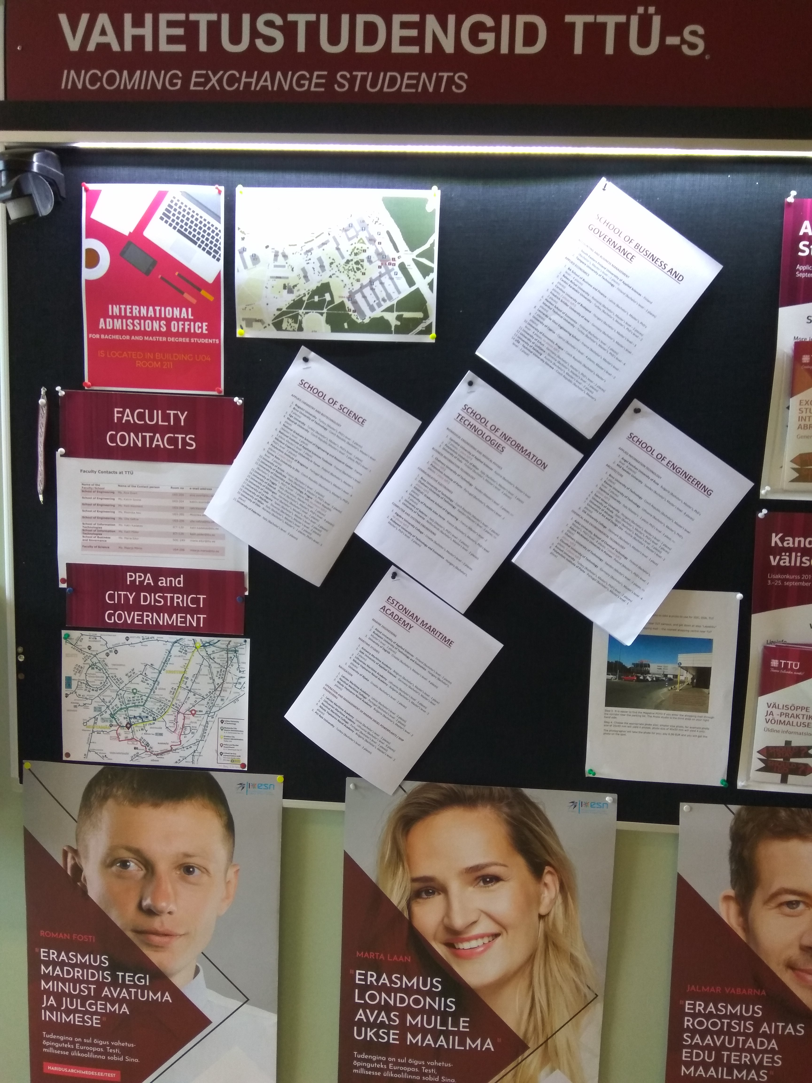
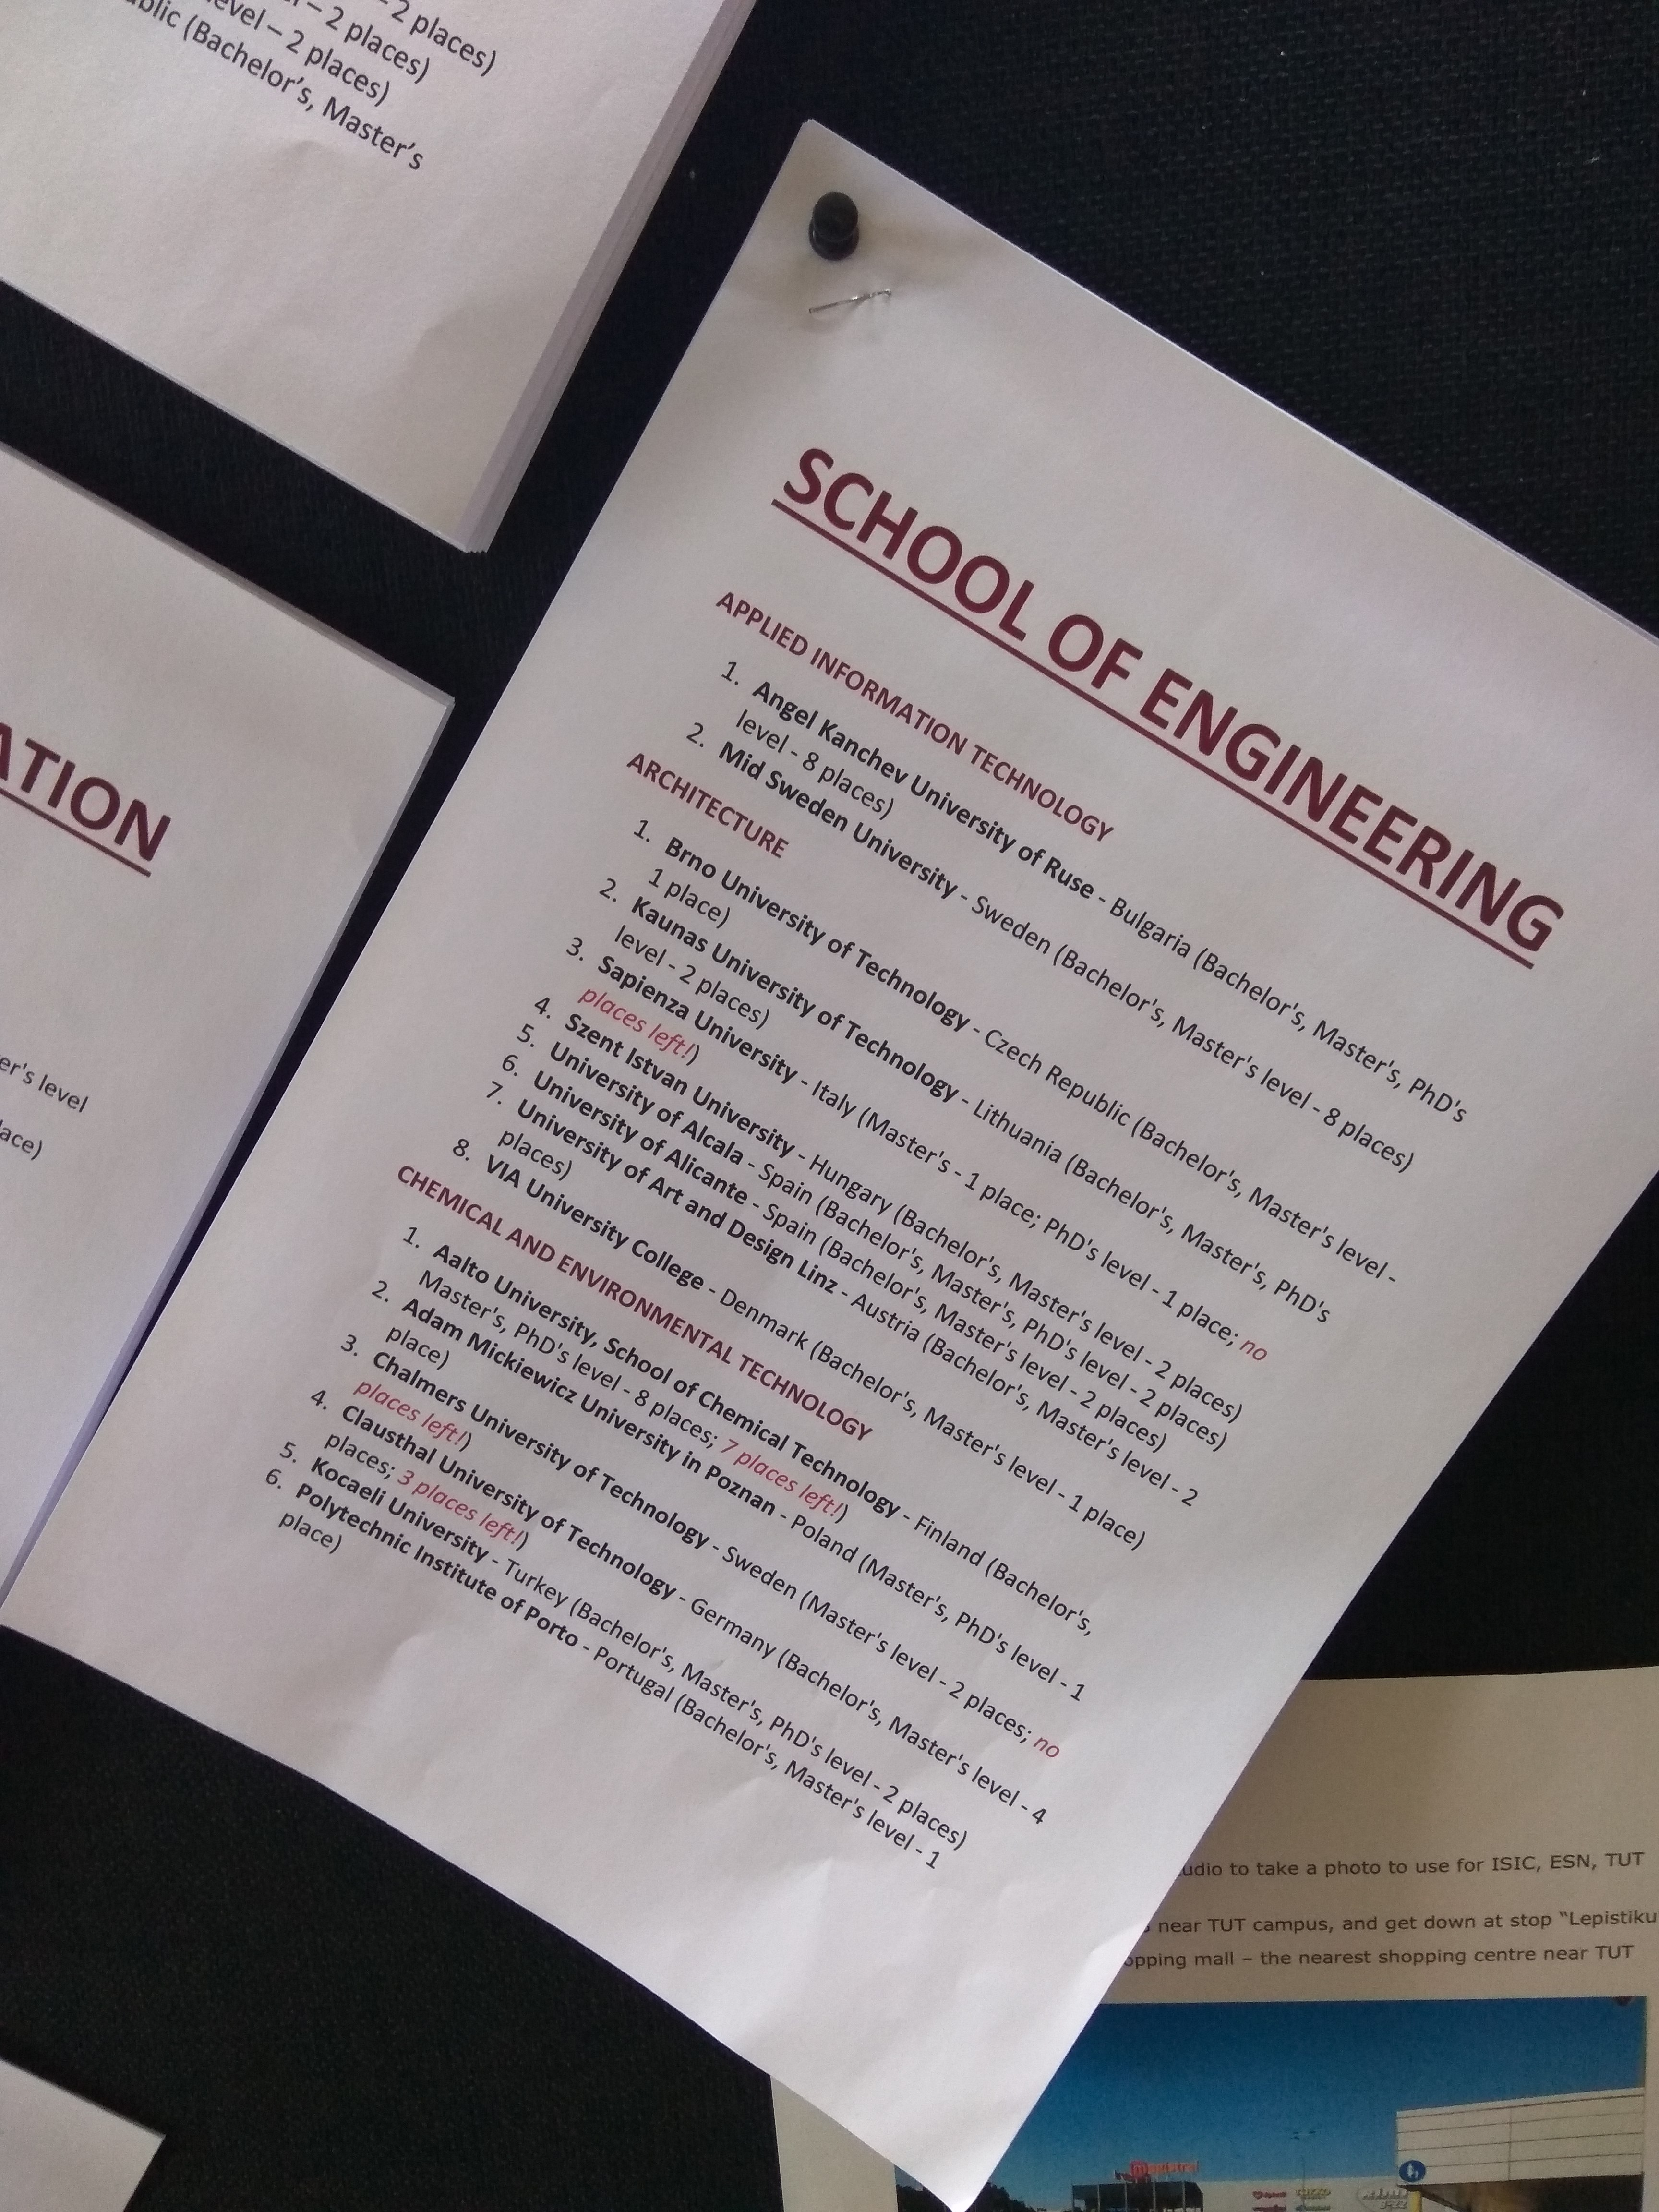
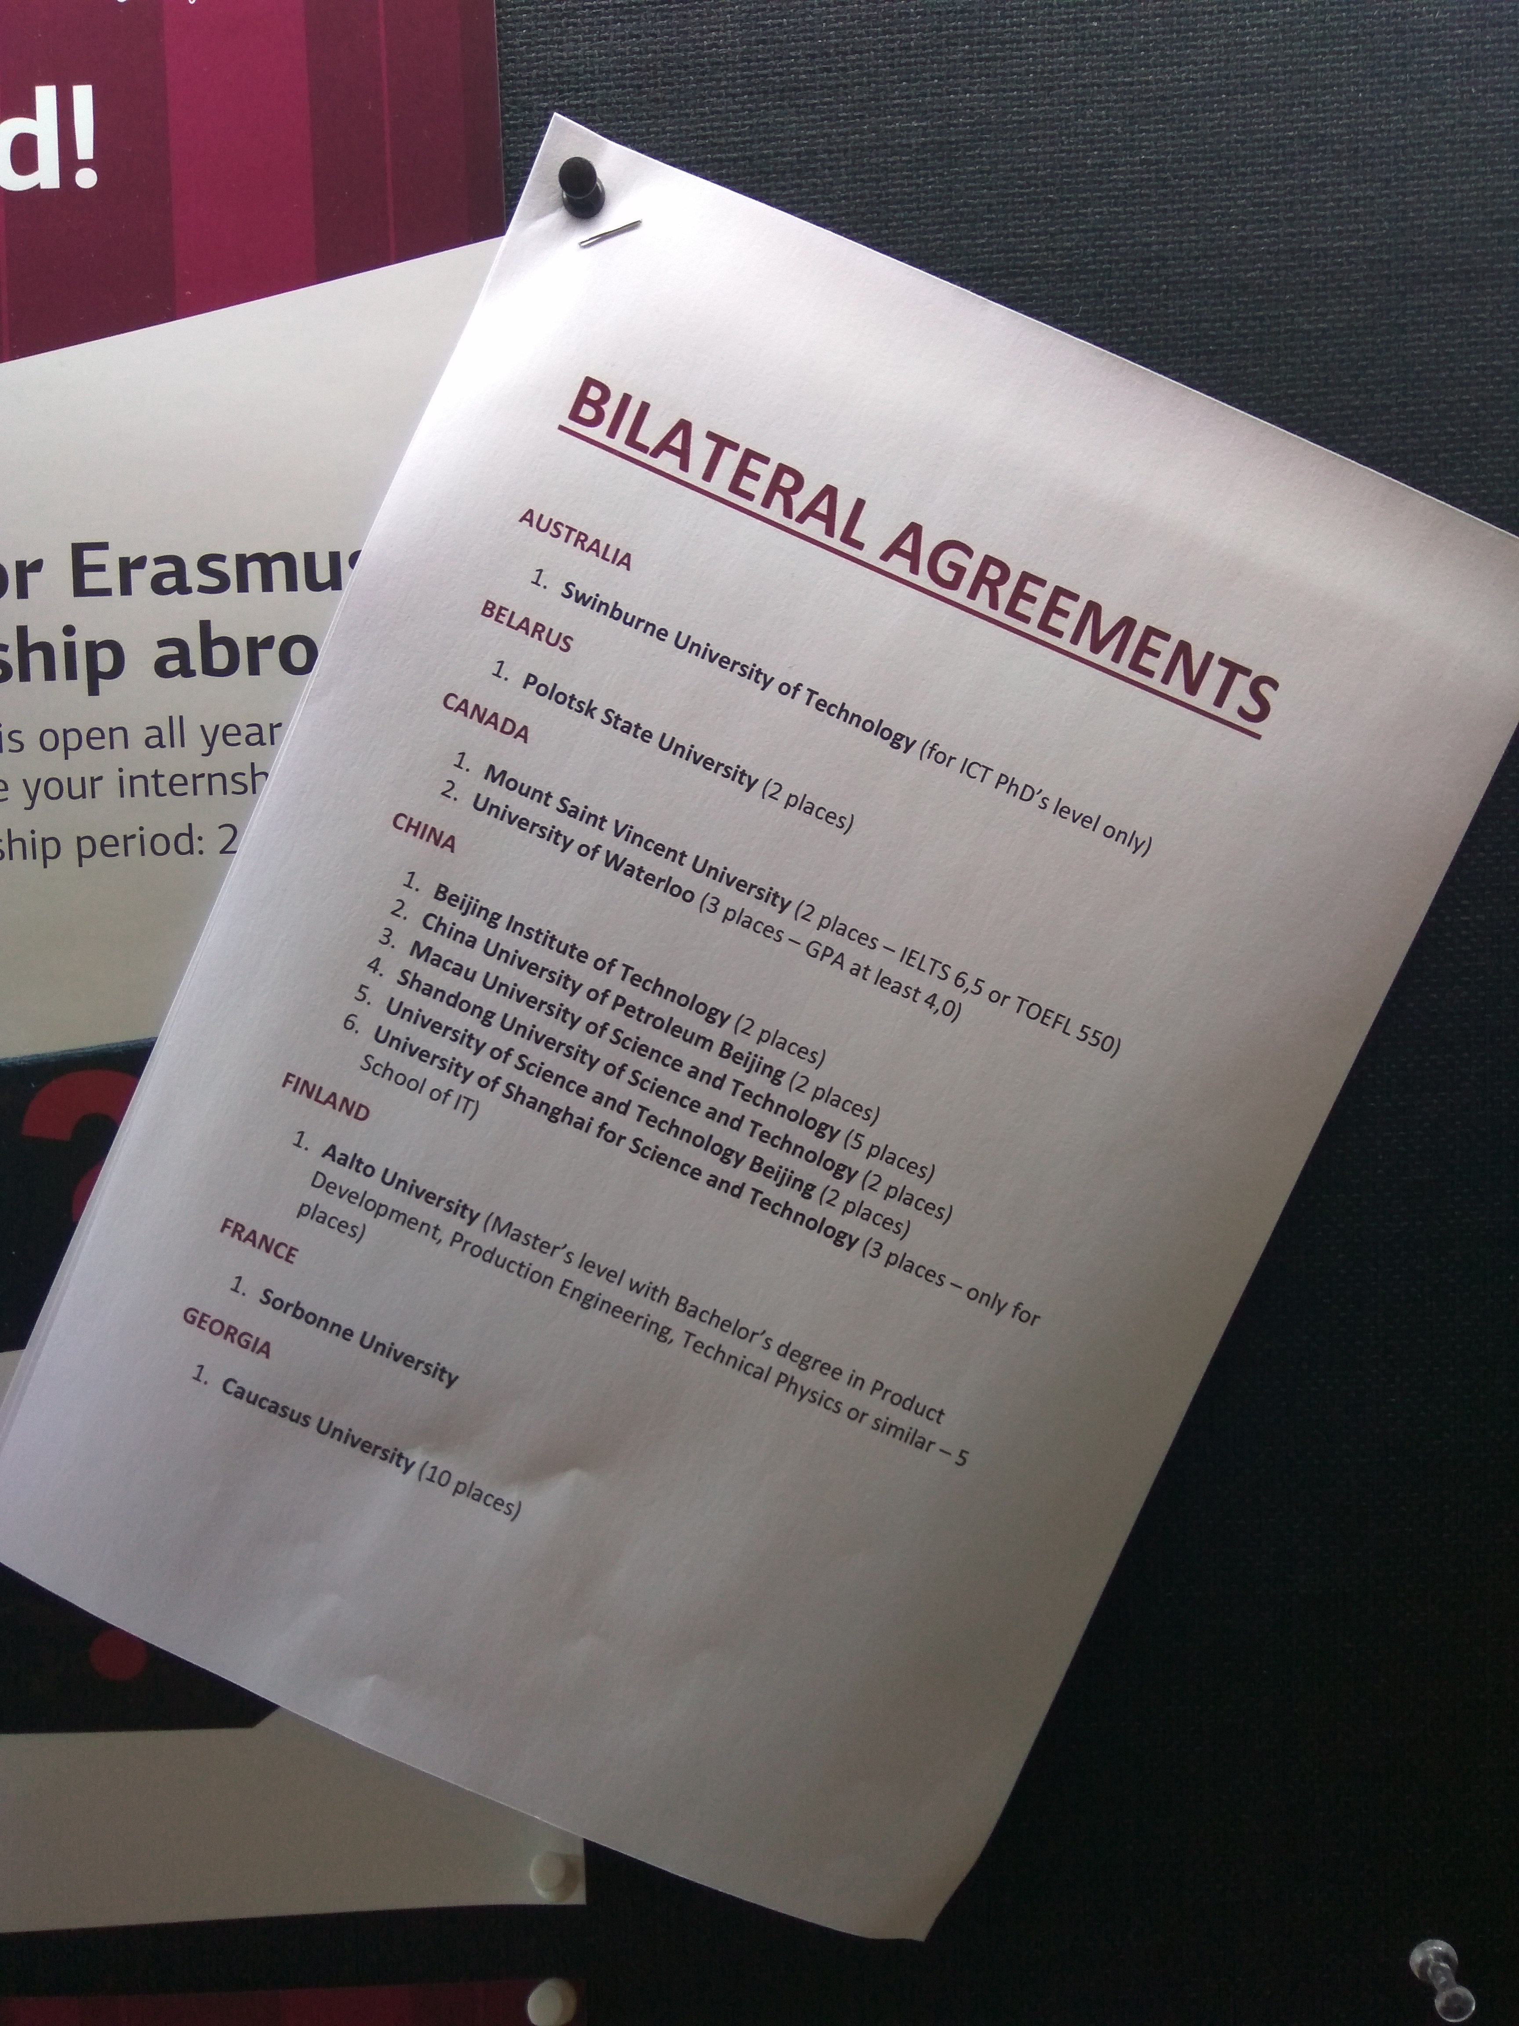
REDEEM 2 involvement
TTÜ has about 700 bilateral cooperation agreements with foreign universities. With about 11 000 students (of which 15% are international students) and about 2000 employees (academic staff 55%).
TTÜ offers diploma, bachelor, master and doctoral programs.

Slide 11
REDEEM 2 involvement
The School of Engineering at TTÜ is in the early phase of developing a new master’s programme that is closely related to Industry 4.0 trend (automation and data exchange in manufacturing technologies).
The one year master degree programme is aimed on the upgrading active mechanical engineers knowledge and skills referred to latest developments in digitalisation of the manufacturing.
The development of the programme is planned in the tight cooperation with representatives of industrial sectors (metalworking machinery and equipment, machine tools, metal working and many others) involved to Estonian Mechanical Engineering Union, Federation of Estonian Engineering Industry, Estonian Plastics Association and so on.

Slide 12
REDEEM 2 staff involved
The contact person:
Ms Betra Leesment, the Study Director, and the Head of the Office of Academic Affairs. The role of the Office of Academic Affairs is to provide support and consultation to study processes (admission, study programme development, registry, educational technology, student mobility, marketing, preparatory courses).
Mr Tauno Otto, a Professor of Department of Mechanical and Industrial Engineering, Programme Director of the bachelor study programme Integrated Engineering. Responsible for the development of new one year curriculum.
Mr Fjodor Sergejev, an Associate Professor, and the Vice Dean for Academic Affairs of School of Engineering. Responsible for administrative support at the level of the faculty (cooperation between schools and departments, study programme quality assurance, financial support, coordination).

Slide 13
TALLINN UNIVERSITY OF TECHNOLOGY
Ehitajate tee 5, 19086 Tallinn
tel + 372 620 3346
fjodor.sergejev@ttu.ee
School of Engineering web:https://www.ttu.ee/?id=151813

